Slide 1
DATA STRUCTURES
Source-https://www.slideserve.com
UNIT - I
Linear structures

Slide 2
What is an abstract data type?
A data type consists of a collection of values together with a set of basic operations on these values
A data type is an abstract data type if the programmers who use the type do not have access to the details of how the values and operations are implemented.
All pre-defined types such as int, double, … are abstract data types
An abstract data type is a ‘concrete’ type, only implementation is ‘abstract’

Slide 3
Linked Lists
A linked list is a linear collection of data elements, called nodes, where the linear order is given by means of pointers.
Each node is divided into two parts:
  The first part contains the information of the element and
  The second part contains the address of the next node (link /next pointer field) in the list.

Slide 4
Types of Linked list
Singly Linked list
Circularly Linked list
Doubly linked list

Slide 5
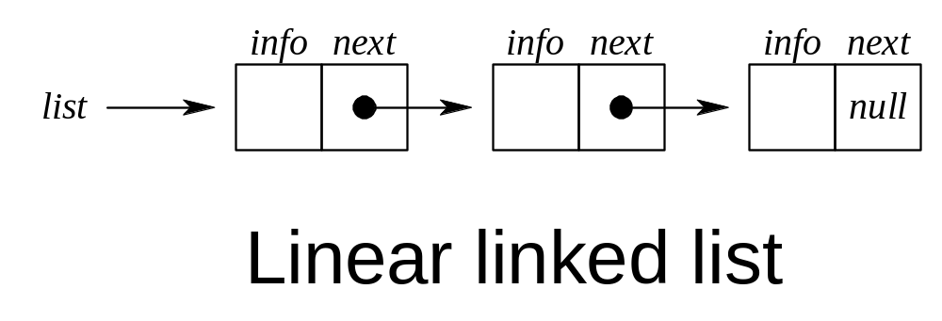
Linked Lists

Slide 6
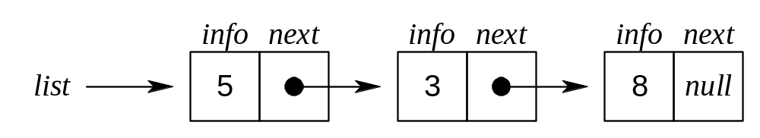
Adding an Element to the front of a Linked List

Slide 7
Some Notations for use in algorithm (Not in C programs)
p: is a pointer
node(p): the node pointed to by p
info(p): the information portion of the node
next(p): the next address portion of the node
getnode(): obtains an empty node
freenode(p): makes node(p) available for reuse even if the value of the pointer p is changed.

Slide 8
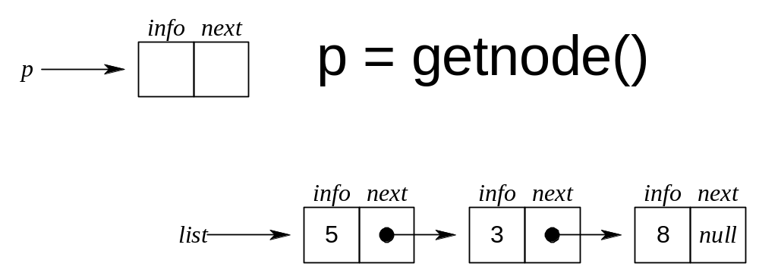
Adding an Element to the front of a Linked List

Slide 9
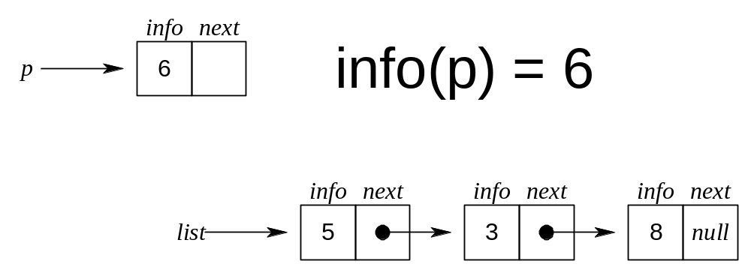
Adding an Element to the front of a Linked List

Slide 10
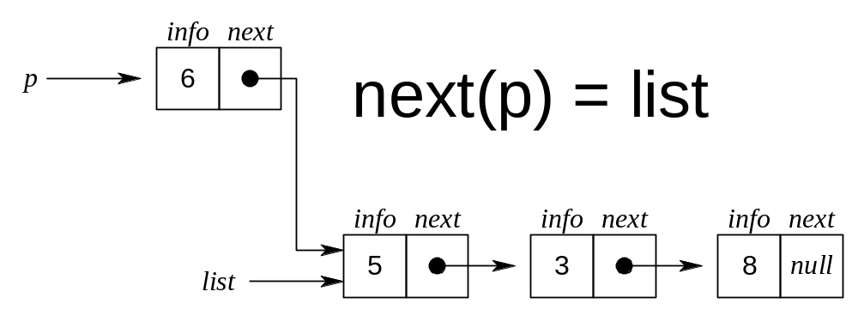
Adding an Element to the front of a Linked List

Slide 11
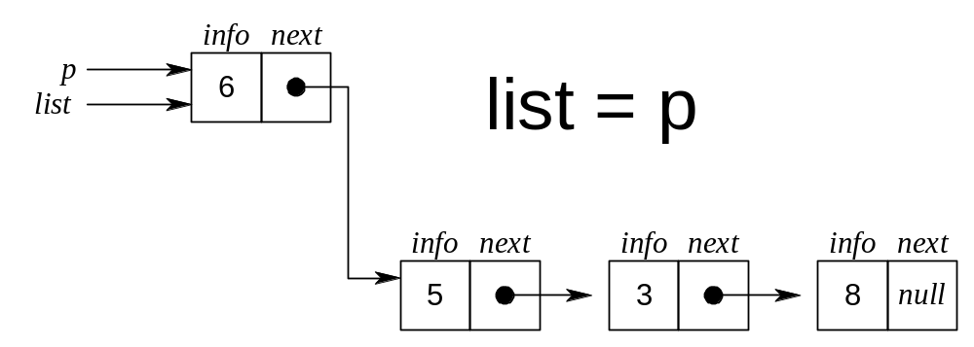
Adding an Element to the front of a Linked List

Slide 12
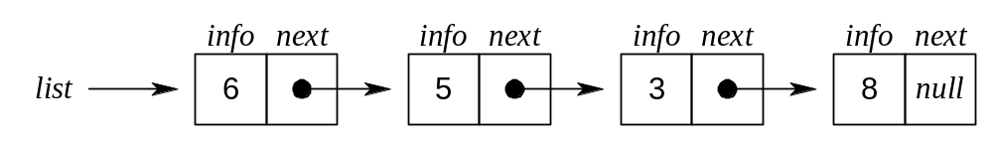
Adding an Element to the front of a Linked List

Slide 13
Removing an Element from the front of a Linked List

Slide 14
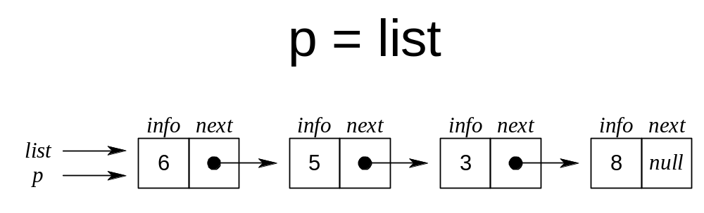
Removing an Element from the front of a Linked List

Slide 15
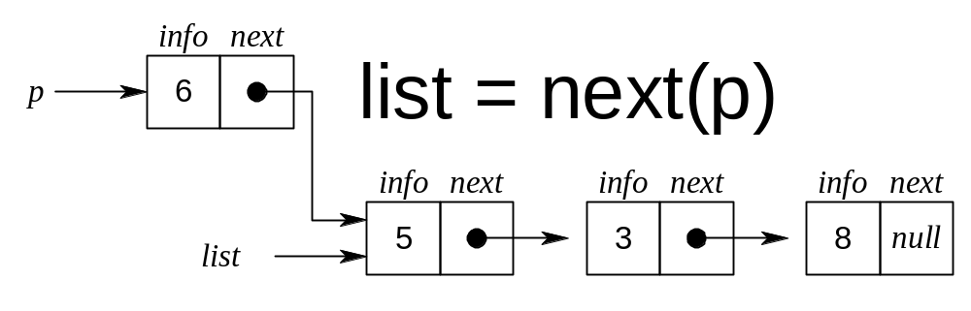
Removing an Element from the front of a Linked List

Slide 16
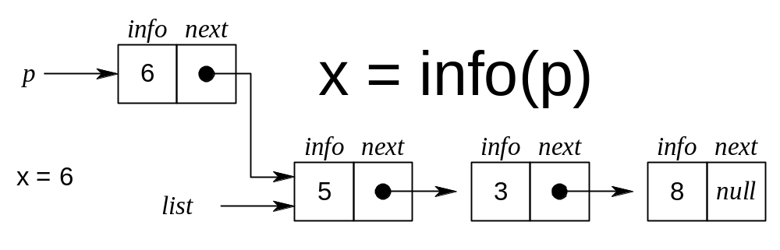
Removing an Element from the front of a Linked List

Slide 17
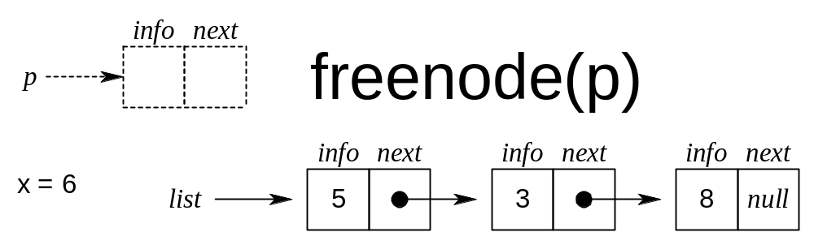
Removing an Element from the front of a Linked List

Slide 18
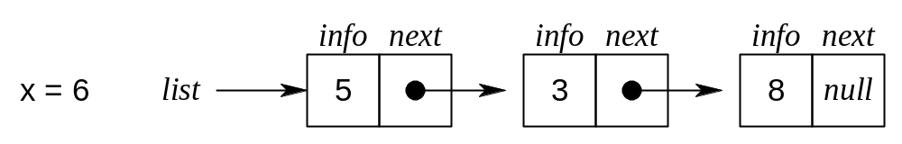
Removing an Element from the front of a Linked List

Slide 19
Circular Linked Lists
In linear linked lists if a list is traversed (all the elements visited) an external pointer to the list must be preserved in order to be able to reference the list again.
Circular linked lists can be used to help the traverse the same list again and again if needed. A circular list is very similar to the linear list where in the circular list the pointer of the last node points not NULL but the first node.

Slide 20

Circular Linked Lists
A Linear Linked List

Slide 21
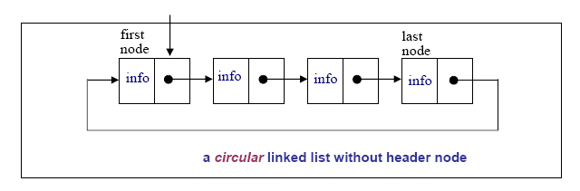
Circular Linked Lists

Slide 22
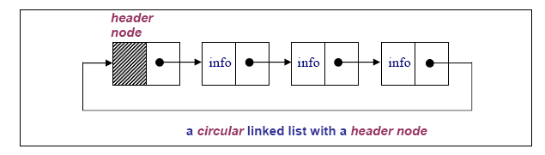
Circular Linked Lists

Slide 23
Circular Linked Lists
In a circular linked list there are two methods to know if a node is the first node or not.
  Either a external pointer, list, points the first node or
  A header node is placed as the first node of the circular list.
The header node can be separated from the others by either heaving a sentinel value as the info part or having a dedicated flag variable to specify if the node is a header node or not.

Slide 24
PRIMITIVE FUNCTIONS IN CIRCULAR LISTS
The structure definition of the circular linked lists and the linear linked list is the same:
struct node{
int info;
struct node *next;
};
typedef struct node *NODEPTR;

Slide 25
DOUBLY LINKED LISTS
The circular lists have advantages over the linear lists. However, you can only traverse the circular list in one (i.e. forward) direction, which means that you cannot traverse the circular list in backward direction.
This problem can be overcome by using doubly linked lists where there three fields
Each node in doubly linked list can be declared by:
  struct node
  {
    int info;
    struct node *left, *right;
  };
  typedef struct node nodeptr;

Slide 26
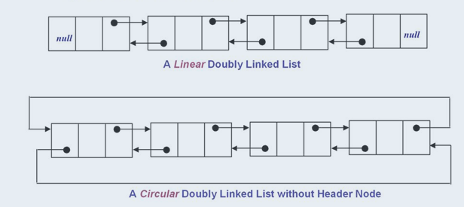
Doubly Linked List

Slide 27
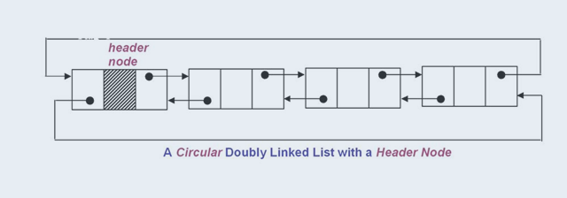
Doubly Linked List with Header

Slide 28
Applications of Linked List
Polynomial ADT
Radix Sort
Multi List

Slide 29
Stacks
Outline
Stacks
  Definition
  Basic Stack Operations
  Array Implementation of Stacks

Slide 30
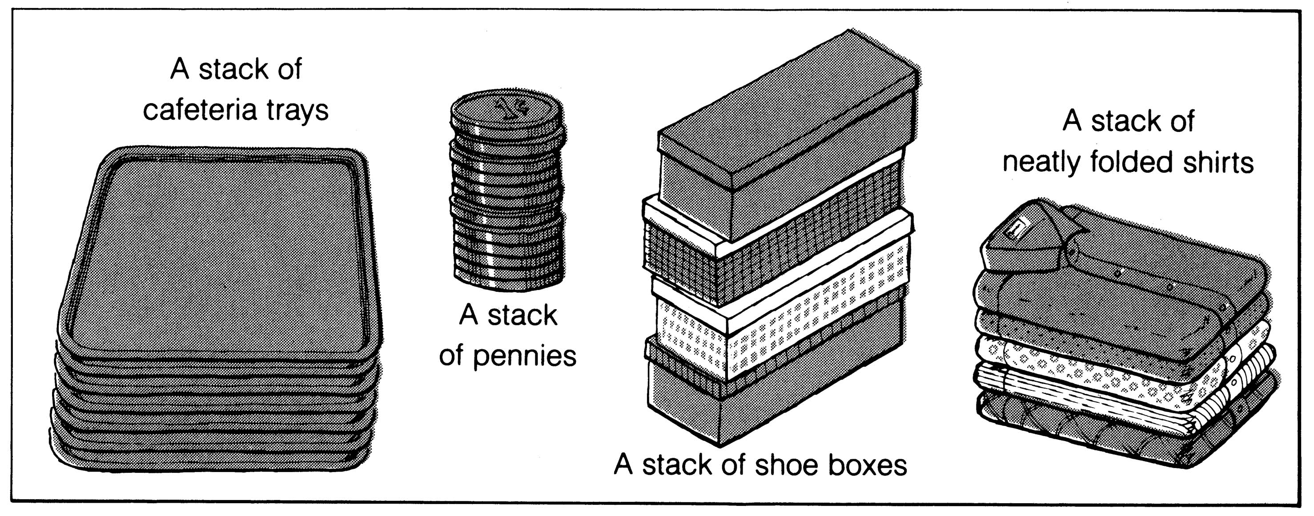
What is a stack?
It is an ordered group of homogeneous items of elements.
Elements are added to and removed from the top of the stack (the most recently added items are at the top of the stack).
The last element to be added is the first to be removed (LIFO: Last In, First Out).

Slide 31
BASIC STACK OPERATIONS
Initialize the Stack.
Pop an item off the top of the stack (delete an item)
Push an item onto the top of the stack (insert an item)
Is the Stack empty?
Is the Stack full?
Clear the Stack
Determine Stack Size

Slide 32
Array Implementation of the Stacks
The stacks can be implemented by the use of arrays and linked lists.
  One way to implement the stack is to have a data structure where a variable called top keeps the location of the elements in the stack (array)
  An array is used to store the elements in the stack

Slide 33
Stack Definition
struct STACK{
int count; /* keeps the number of elements in the stack */
int top; /* indicates the location of the top of the stack*/
int items[STACKSIZE]; /*array to store the stack elements*/
}

Slide 34
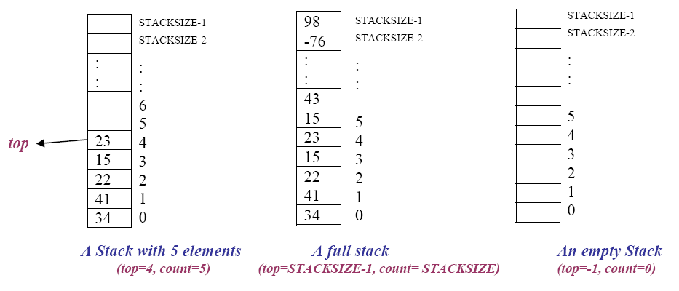
Stacks

Slide 35
Stack Initialisation
initialize the stack by assigning -1 to the top pointer to indicate that the array based stack is empty (initialized) as follows:
You can write following lines in the main program:
  :
  STACK s;
  s.top = -1;
  :

Slide 36
Stack Initialisation
Alternatively you can use the following function:
void StackInitialize(STACK *Sptr)
{
Sptr->top=-1;
}

Slide 37
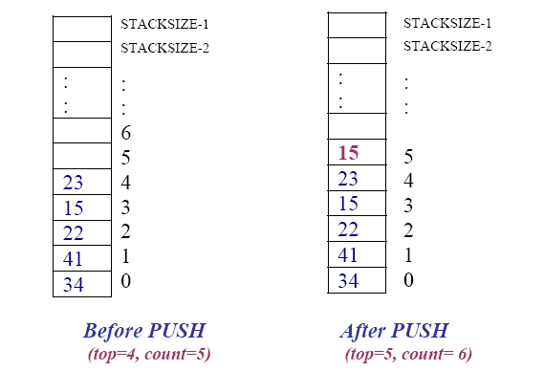
Push Operation
Push an item onto the top of the stack (insert an item)

Slide 38
Void push (Stack *, type newItem)
Function: Adds newItem to the top of the stack.
Preconditions: Stack has been initialized and is not full.
Postconditions: newItem is at the top of the stack.

Slide 39
void push (STACK *, type newItem)
void push(STACK *Sptr, int ps) /*pushes ps into stack*/
{
  if(Sptr->top == STACKSIZE-1){
    printf("Stack is full\n");
    return; /*return back to main function*/
}
else {
    Sptr->top++;
    Sptr->items[Sptr->top]= ps;
    Sptr->count++;
}
}

Slide 40
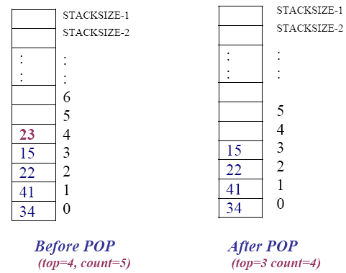
Pop operation
Pop an item off the top of the stack (delete an item)

Slide 41
type pop (STACK *)
Function: Removes topItem from stack and returns with topItem
Preconditions: Stack has been initialized and is not empty.
Postconditions: Top element has been removed from stack and the function returns with the top element.

Slide 42
Type pop(STACK *Sptr)
int pop(STACK *Sptr)
{
int pp;
if(Sptr->top == -1){
  printf("Stack is empty\n");
  return -1; /*exit from the function*/
}
else {
  pp = Sptr->items[Sptr->top];
  Sptr->top--;
  Sptr->count--;
return pp;
  }
}

Slide 43
void pop(STACK *Sptr, int *pptr)
void pop(STACK *Sptr, int *pptr)
{
if(Sptr->top == -1){
  printf("Stack is empty\n");
  return;/*return back*/
}
else {
  *pptr = Sptr->items[Sptr->top];
  Sptr->top--;
  Sptr->count--;
}
}

Slide 44
Applications of stack
Balancing Symbols
Infix,postfix,prefix conversion
Function call
Expression Evaluation
Reversing a String
Palindrome Example

Slide 45

DEFINITION OF QUEUE
A Queue is an ordered collection of items from which items may be deleted at one end (called the front of the queue) and into which items may be inserted at the other end (the rear of the queue).
The first element inserted into the queue is the first element to be removed. For this reason a queue is sometimes called a fifo (first-in first-out) list as opposed to the stack, which is a lifo (last-in first-out).

Slide 46
Queue
items[MAXQUEUE-1]
. | .
. | .
. | .
items[2] | C
items[1] | B
items[0] | A
Rear=2
Front=0

Slide 47
Declaration of a Queue
# define MAXQUEUE 50 /* size of the queue items*/
typedef struct {
int front;
int rear;
int items[MAXQUEUE];
}QUEUE;

Slide 48
QUEUE OPERATIONS
Initialize the queue
Insert to the rear of the queue
Remove (Delete) from the front of the queue
Is the Queue Empty
Is the Queue Full
What is the size of the Queue

Slide 49
INITIALIZE THE QUEUE
The queue is initialized by having the rear set to -1, and front set to 0. Let us assume that maximum number of the element we have in a queue is MAXQUEUE elements as shown below.
items[MAXQUEUE-1]
. | .
. | .
.
items[1]
items[0] |  | front=0
 |  | rear=-1

Slide 50
insert(&Queue, ‘A’)
an item (A) is inserted at the Rear of the queue
items[MAXQUEUE-1]
. | .
. | .
items[3]
items[2]
items[1]
items[0] | A | Front=0, Rear=0

Slide 51
insert(&Queue, ‘B’)
A new item (B) is inserted at the Rear of the queue
items[MAXQUEUE-1]
. | .
. | .
items[3]
items[2]
items[1] | B | Rear=1
items[0] | A | Front=0

Slide 52
insert(&Queue, ‘C’)
A new item (C) is inserted at the Rear of the queue
items[MAXQUEUE-1]
. | .
. | .
items[3]
items[2] | C | Rear=2
items[1] | B
items[0] | A | Front=0

Slide 53
insert(&Queue, ‘D’)
A new item (D) is inserted at the Rear of the queue
items[MAXQUEUE-1]
. | .
. | .
items[3] | D | Rear=3
items[2] | C
items[1] | B
items[0] | A | Front=0

Slide 54
Insert Operation
  void insert(QUEUE *qptr, char x)
  {
    if(qptr->rear == MAXQUEUE-1)
    {
    printf("Queue is full!");
    exit(1);
    }
    else
    {
    qptr->rear++;
    qptr->items[qptr->rear]=x;
    }
}

Slide 55
char remove(&Queue)
an item (A) is removed (deleted) from the Front of the queue
items[MAXQUEUE-1]
. | .
. | .
items[3] | D | Rear=3
items[2] | C
items[1] | B | Front=1
items[0] | A

Slide 56
char remove(&Queue)
Remove two items from the front of the queue.
items[MAXQUEUE-1]
. | .
. | .
items[3] | D | Rear=3
items[2] | C | Front=2
items[1] | B
items[0] | A

Slide 57
char remove(&Queue)
Remove two items from the front of the queue.
items[MAXQUEUE-1]
. | .
. | .
items[3] | D | Front=Rear=3
items[2] | C
items[1] | B
items[0] | A

Slide 58
char remove(&Queue)
Remove one more item from the front of the queue.
items[MAXQUEUE-1]
. | .
items[4] |  | Front=4
items[3] | D | Rear=3
items[2] | C
items[1] | B
items[0] | A

Slide 59
Remove Operation
  char remove(struct queue *qptr)
  {
  char p;
  if(qptr->front > qptr->rear){
  printf("Queue is empty");
  exit(1);
  }
  else
  {p=qptr->items[qptr->front];
  qptr->front++;
  return p;
  }
}

Slide 60
INSERT / REMOVE ITEMS
Assume that the rear= MAXQUEUE-1
items[MAXQUEUE-1] | X | rear=MAXQUEUE-1
. | .
. | .
items[3] | D | front=3
items[2] | C
items[1] | B
items[0] | A
What happens if we want to insert a new item into the queue?

Slide 61
INSERT / REMOVE ITEMS
What happens if we want to insert a new item F into the queue?
Although there is some empty space, the queue is full.
One of the methods to overcome this problem is to shift all the items to occupy the location of deleted item.

Slide 62
REMOVE ITEM
items[MAXQUEUE-1]
. | .
. | .
items[3] | D | Rear=3
items[2] | C
items[1] | B | Front=1
items[0] | A

Slide 63
REMOVE ITEM
items[MAXQUEUE-1]
. | .
. | .
items[3] | D | Rear=3
items[2] | C
items[1] | B | Front=1
items[0] | B

Slide 64
REMOVE ITEM
items[MAXQUEUE-1]
. | .
. | .
items[3] | D | Rear=3
items[2] | C
items[1] | C
items[0] | B

Slide 65
REMOVE ITEM
items[MAXQUEUE-1]
. | .
. | .
items[3] | D | Rear=3
items[2] | D
items[1] | C
items[0] | B

Slide 66
REMOVE ITEM
items[MAXQUEUE-1]
. | .
. | .
items[3] | D
items[2] | D | Rear=2
items[1] | C
items[0] | B

Slide 67
Modified Remove Operation
  char remove(struct queue *qptr)
  {
  char p;
  int i;
  if(qptr->front > qptr->rear){
  printf("Queue is empty");
  exit(1);
  }
  else
  {p=qptr->items[qptr->front];
  for(i=1;i<=qptr->rear;i++)
  qptr->items[i-1]=qptr->items[i];
  qptr->rear--
  return p;
  }
}

Slide 68
INSERT / REMOVE ITEMS
Since all the items in the queue are required to shift when an item is deleted, this method is not preferred.
The other method is circular queue.
When rear = MAXQUEUE-1, the next element is entered at items[0] in case that spot is free.

Slide 69
Initialize the queue.
items[6] |  | front=rear=6
items[5]
items[4]
items[3]
items[2]
items[1]
items[0]

Slide 70
Insert items into circular queue
Insert A,B,C to the rear of the queue.
items[6] |  | front=6
items[5]
items[4]
items[3]
items[2]
items[1]
items[0] | A | rear=0

Slide 71
Insert items into circular queue
Insert A,B,C to the rear of the queue.
items[6] |  | front=6
items[5]
items[4]
items[3]
items[2]
items[1] | B | rear=1
items[0] | A

Slide 72
Insert items into circular queue
Insert A,B,C to the rear of the queue.
items[6] |  | front=6
items[5]
items[4]
items[3]
items[2] | C | rear=2
items[1] | B
items[0] | A

Slide 73
Remove items from circular queue
Remove two items from the queue.
items[6]
items[5]
items[4]
items[3]
items[2] | C | rear=2
items[1] | B
items[0] | A | front=0

Slide 74
Remove items from circular queue
Remove two items from the queue.
items[6]
items[5]
items[4]
items[3]
items[2] | C | rear=2
items[1] | B | front=1
items[0] | A

Slide 75
Remove items from circular queue
Remove one more item from the queue.
items[6]
items[5]
items[4]
items[3]
items[2] | C | rear=front=2
items[1] | B
items[0] | A

Slide 76
Insert D,E,F,G to the queue.
items[6] | G | rear=6
items[5] | F
items[4] | E
items[3] | D
items[2] | C | front=2
items[1] | B
items[0] | A

Slide 77
Insert H and I to the queue.
items[6] | G
items[5] | F
items[4] | E
items[3] | D
items[2] | C | front=2
items[1] | B
items[0] | H | rear=0

Slide 78
Insert H and I to the queue.
items[6] | G
items[5] | F
items[4] | E
items[3] | D
items[2] | C | front=2
items[1] | I
items[0] | H | rear=0

Slide 79
Insert J to the queue.
items[6] | G
items[5] | F
items[4] | E
items[3] | D
items[2] | ?? | front=rear=2
items[1] | I
items[0] | H

Slide 80
Declaration and Initialization of a Circular Queue.
  #define MAXQUEUE 10 /* size of the queue items*/
  typedef struct {
  int front;
  int rear;
  int items[MAXQUEUE];
  }QUEUE;
  QUEUE q;
  q.front = MAXQUEUE-1;
  q.rear= MAXQUEUE-1;
Initialization

Slide 81
Insert Operation for circular Queue
  void insert(QUEUE *qptr, char x)
  {
  if(qptr->rear == MAXQUEUE-1)
  qptr->rear=0;
  else
  qptr->rear++;
  /* or qptr->rear=(qptr->rear+1)%MAXQUEUE) */
  if(qptr->rear == qptr->front){
  printf("Queue overflow");
  exit(1);
  }
  qptr->items[qptr->rear]=x;
  }

Slide 82
Remove Operation for circular queue
  char remove(struct queue *qptr)
  {
  if(qptr->front == qptr->rear){
  printf("Queue underflow");
  exit(1);
  }
  if(qptr->front == MAXQUEUE-1)
  qptr->front=0;
  else
  qptr->front++;
  return qptr->items[qptr->front];
  }

Slide 83
Applications of Queue
Real life queue(Ticket Counter)
Jobs in Printer
Networks

Slide 84
DATA STRUCTURES
UNIT II
Tree structures

Slide 85
Trees
Linear access time of linked lists is prohibitive
  Does there exist any simple data structure for which the running time of most operations (search, insert, delete) is O(log N)?

Slide 86
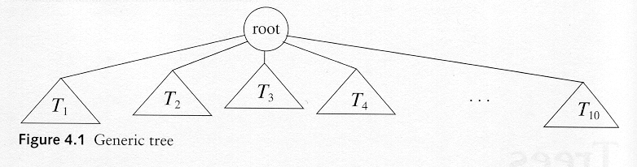
Trees
A tree is a collection of nodes
  The collection can be empty
  (recursive definition) If not empty, a tree consists of a distinguished node r (the root), and zero or more nonempty subtrees T₁, T₂, ...., T_{k}, each of whose roots are connected by a directed edge from r

Slide 87
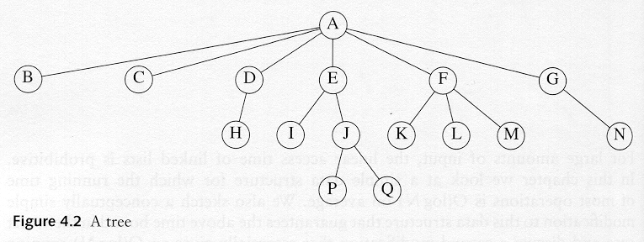
Some Terminologies
Child and parent
  Every node except the root has one parent
  A node can have an arbitrary number of children
Leaves
  Nodes with no children
Sibling
  nodes with same parent

Slide 88
Some Terminologies
Path
Length
  number of edges on the path
Depth of a node
  length of the unique path from the root to that node
  The depth of a tree is equal to the depth of the deepest leaf
Height of a node
  length of the longest path from that node to a leaf
  all leaves are at height 0
  The height of a tree is equal to the height of the root
Ancestor and descendant
  Proper ancestor and proper descendant

Slide 89
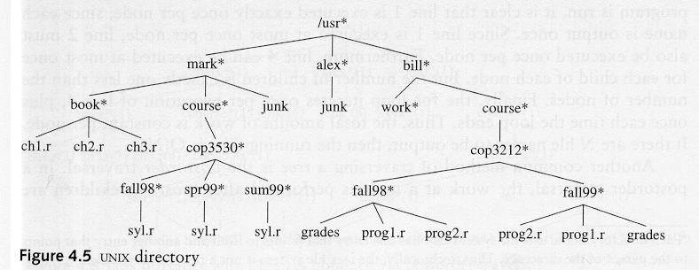
Example: UNIX Directory

Slide 90
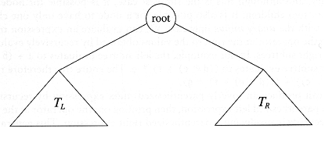
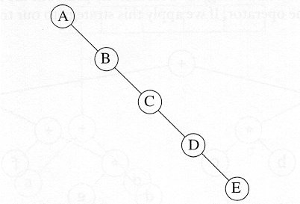
Binary Trees
A tree in which no node can have more than two children
The depth of an “average” binary tree is considerably smaller than N, eventhough in the worst case, the depth can be as large as N – 1.

Slide 91
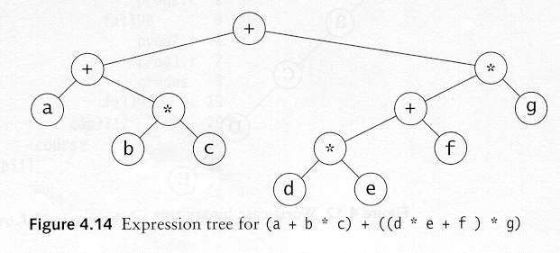
Example: Expression Trees
Leaves are operands (constants or variables)
The other nodes (internal nodes) contain operators
Will not be a binary tree if some operators are not binary

Slide 92
Tree traversal
Used to print out the data in a tree in a certain order
Pre-order traversal
  Print the data at the root
  Recursively print out all data in the left subtree
  Recursively print out all data in the right subtree

Slide 93
Preorder, Post order and In order
Preorder traversal
  node, left, right
  prefix expression
    ++a*bc*+*defg

Slide 94
Preorder, Post order and In order
Postorder traversal
  left, right, node
  postfix expression
    abc*+de*f+g*+
Inorder traversal
  left, node, right.
  infix expression
    a+b*c+d*e+f*g

Slide 95
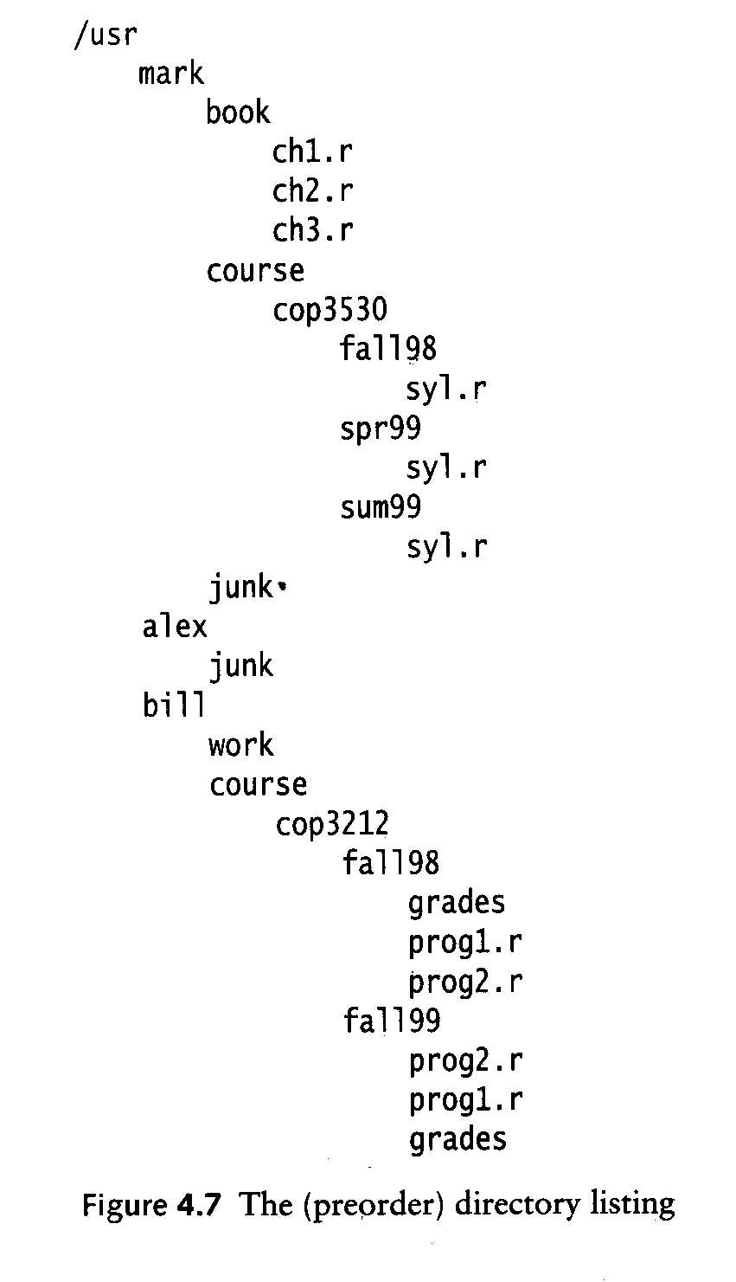
Preorder

Slide 96
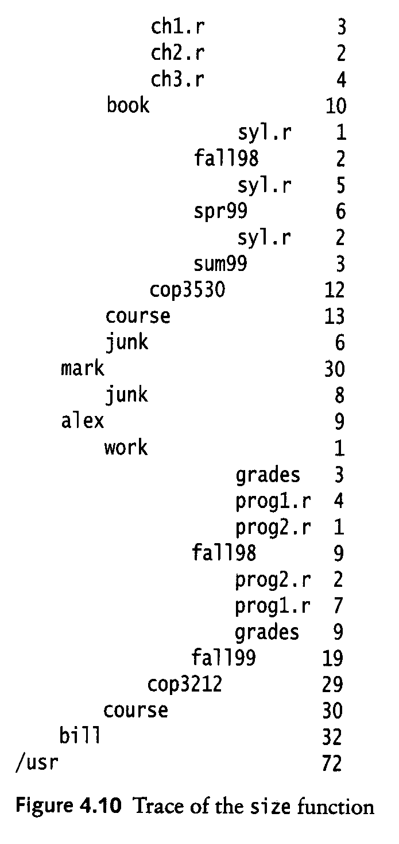
Postorder

Slide 97
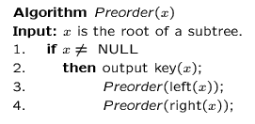
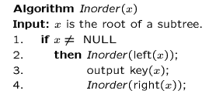
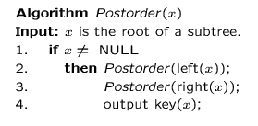
Preorder, Post-order and In-order

Slide 98
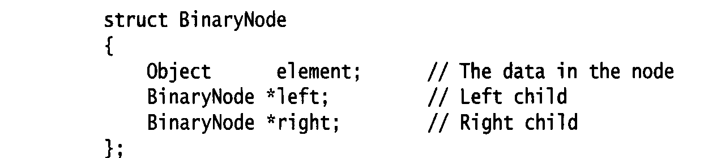
Binary Trees
Possible operations on the Binary Tree ADT
  parent
  left_child, right_child
  sibling
  root, etc
Implementation
  Because a binary tree has at most two children, we can keep direct pointers to them

Slide 99
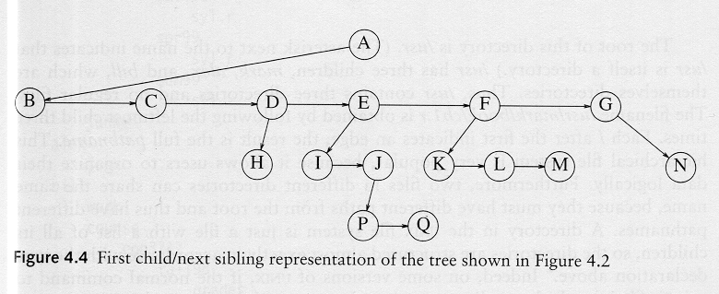
compare: Implementation of a general tree

Slide 100
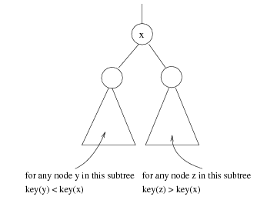
Binary Search Trees
Stores keys in the nodes in a way so that searching, insertion and deletion can be done efficiently.
Binary search tree property
  For every node X, all the keys in its left subtree are smaller than the key value in X, and all the keys in its right subtree are larger than the key value in X

Slide 101
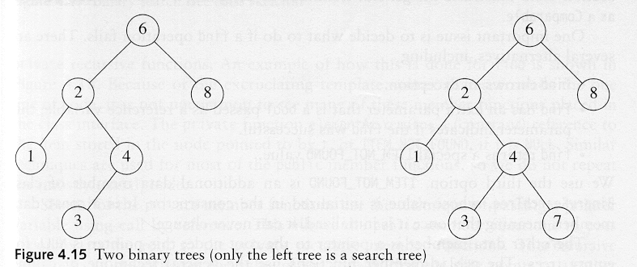
Binary Search Trees
A binary search tree
Not a binary search tree

Slide 102
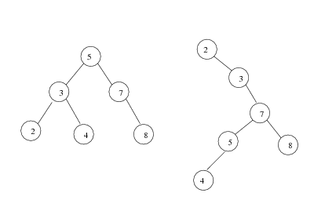
Binary search trees
Two binary search trees representing
the same set:
Average depth of a node is O(log N); maximum depth of a node is O(N)

Slide 103
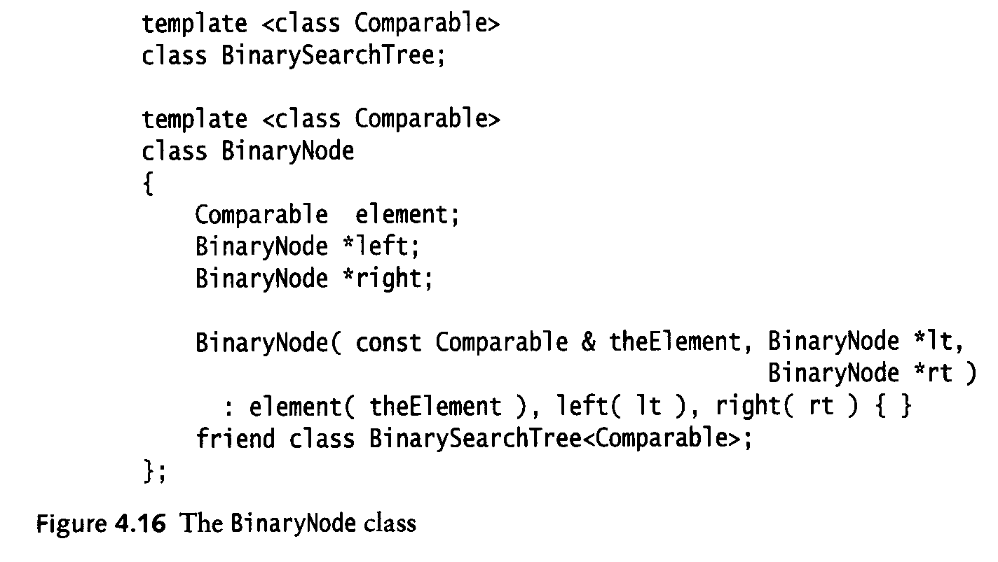
Implementation

Slide 104
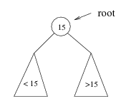
Searching BST
If we are searching for 15, then we are done.
If we are searching for a key < 15, then we should search in the left subtree.
If we are searching for a key > 15, then we should search in the right subtree.

Slide 105
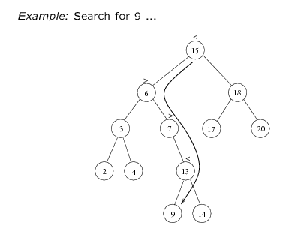
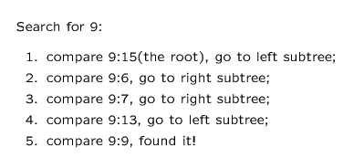

Slide 106
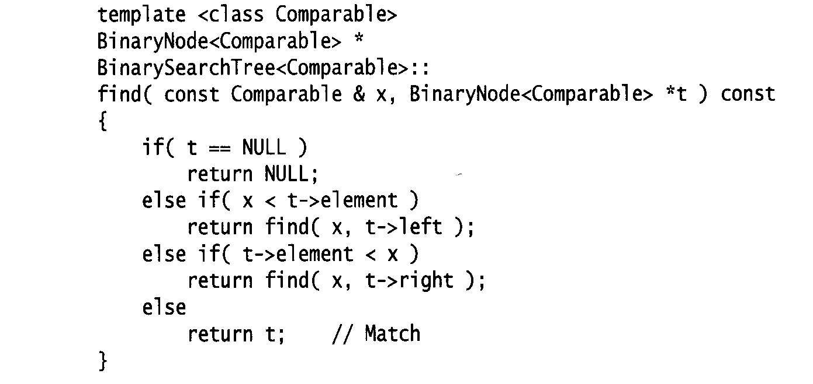
Searching (Find)
Find X: return a pointer to the node that has key X, or NULL if there is no such node
Time complexity
  O(height of the tree)

Slide 107
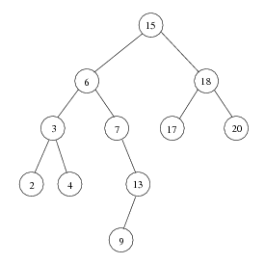
In-order traversal of BST
Print out all the keys in sorted order
Inorder: 2, 3, 4, 6, 7, 9, 13, 15, 17, 18, 20

Slide 108
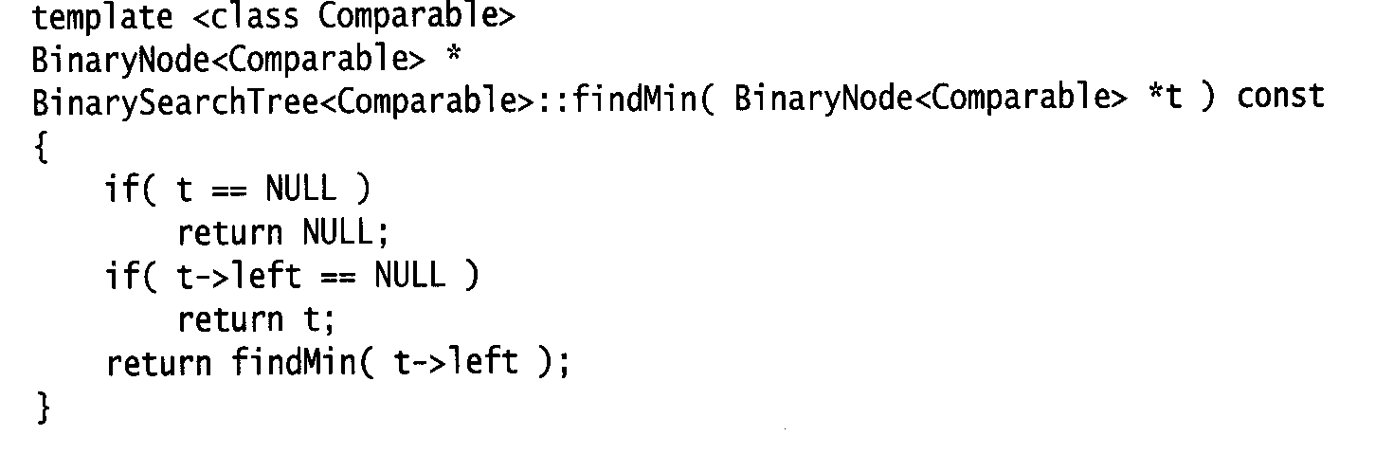
Find Min/ find Max
Return the node containing the smallest element in the tree
Start at the root and go left as long as there is a left child. The stopping point is the smallest element
Similarly for findMax
Time complexity = O(height of the tree)

Slide 109
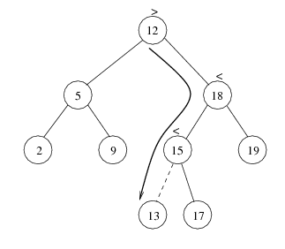
Insert
Proceed down the tree as you would with a find
If X is found, do nothing (or update something)
Otherwise, insert X at the last spot on the path traversed
Time complexity = O(height of the tree)

Slide 110
Delete
When we delete a node, we need to consider how we take care of the children of the deleted node.
  This has to be done such that the property of the search tree is maintained.

Slide 111
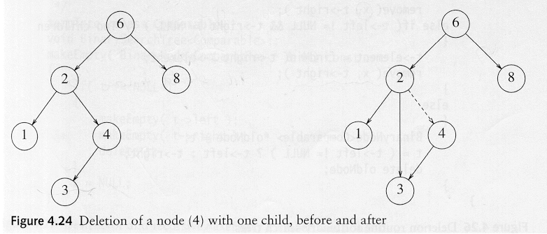
Delete
Three cases:
(1) the node is a leaf
  Delete it immediately
(2) the node has one child
  Adjust a pointer from the parent to bypass that node

Slide 112
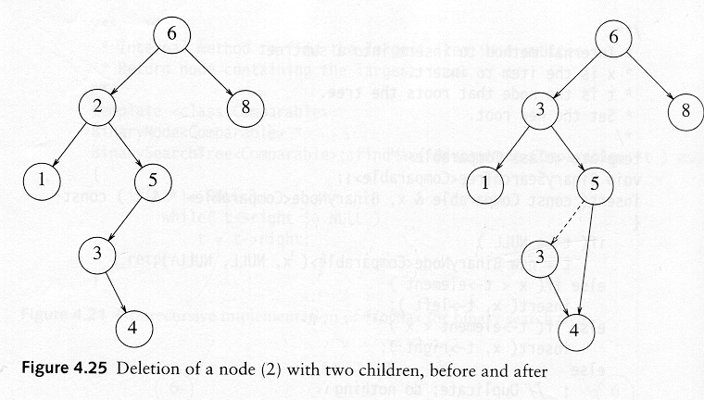
Delete
(3) the node has 2 children
  replace the key of that node with the minimum element at the right sub tree
  delete the minimum element
    Has either no child or only right child because if it has a left child, that left child would be smaller and would have been chosen. So invoke case 1 or 2.
Time complexity = O(height of the tree)

Slide 113
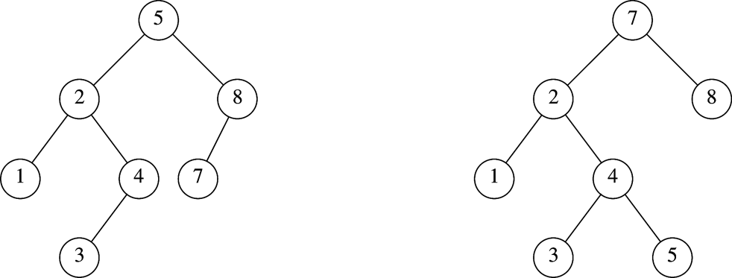
AVL Tree
An AVL (Adelson-Velskii and Landis 1962) tree is a binary search tree in which for every node in the tree, the height of the left and right subtrees differ by at most 1
  .
AVL tree
AVL property violated here

Slide 114
AVL Tree with
Minimum Number of Nodes
N₀ = 1
N₁ = 2
N₂ =4
N₃ = N₁+N₂+1=7

Slide 115
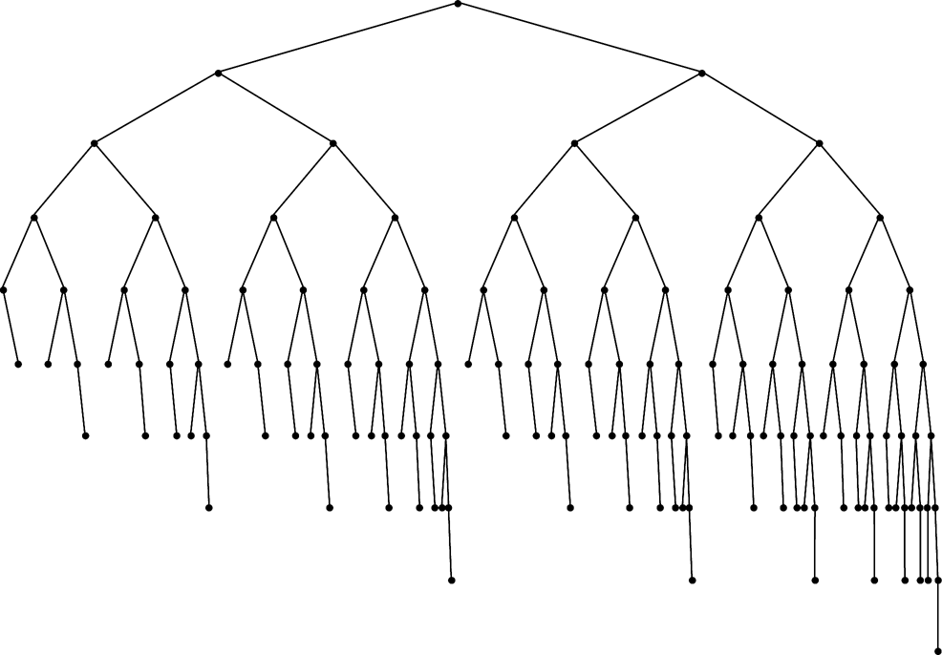
Smallest AVL tree
of height 7
Smallest AVL tree
of height 8
Smallest AVL tree of height 9

Slide 116
Height of AVL Tree
Denote N_{h} the minimum number of nodes in an AVL tree of height h
S(h)=s(h-1)+(s(h-2)+1
For h=6
The minimum number of nodes are
S(6)=s(5)+s(4)+1
S(6)=2^5+2^4+1
S(6)=32+16+1
S(6)=49
Thus, many operations (i.e. searching) on an AVL tree will take O(log N) time

Slide 117
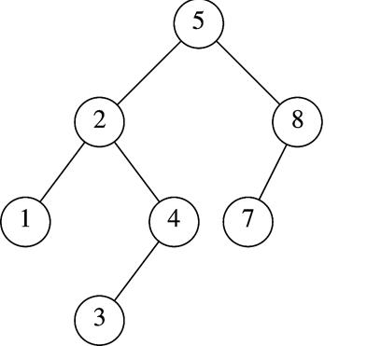
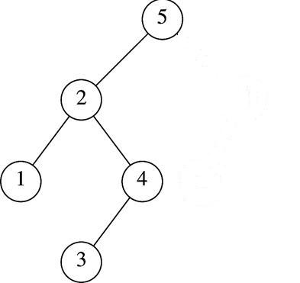
Insertion in AVL Tree
Basically follows insertion strategy of binary search tree
  But may cause violation of AVL tree property
Restore the destroyed balance condition if needed
7
6
8
6
Insert 6
Property violated
Original AVL tree
Restore AVL property

Slide 118
Some Observations
After an insertion, only nodes that are on the path from the insertion point to the root might have their balance altered
  Because only those nodes have their subtrees altered
Rebalance the tree at the deepest such node guarantees that the entire tree satisfies the AVL property
7
6
8
6
Node 5,8,7 might
have balance altered
Rebalance node 7
guarantees the whole tree be AVL

Slide 119
Different Cases for Rebalance
Denote the node that must be rebalanced α
  Case 1: an insertion into the left subtree of the left child of α
  Case 2: an insertion into the right subtree of the left child of α
  Case 3: an insertion into the left subtree of the right child of α
  Case 4: an insertion into the right subtree of the right child of α
Cases 1&4 are mirror image symmetries
with respect to α, as are cases 2&3

Slide 120
Rotations
Rebalance of AVL tree are done with simple modification to tree, known as rotation
Insertion occurs on the “outside” (i.e., left-left or right-right) is fixed by single rotation of the tree
Insertion occurs on the “inside” (i.e., left-right or right-left) is fixed by double rotation of the tree

Slide 121
Insertion Algorithm
First, insert the new key as a new leaf just as in ordinary binary search tree
Then trace the path from the new leaf towards the root. For each node x encountered, check if heights of left(x) and right(x) differ by at most 1
  If yes, proceed to parent(x)
  If not, restructure by doing either a single rotation or a double rotation
Note: once we perform a rotation at a node x, we won’t need to perform any rotation at any ancestor of x.

Slide 122

Single Rotation to Fix Case 1(left-left)
k2 violates
An insertion in subtree X,
AVL property violated at node k2
Solution: single rotation

Slide 123

Single Rotation Case 1 Example
k2
k1
k1
X
k2
X

Slide 124

Single Rotation to Fix Case 4 (right-right)
k1 violates
An insertion in subtree Z
Case 4 is a symmetric case to case 1
Insertion takes O(Height of AVL Tree) time, Single rotation takes O(1) time

Slide 125
Single Rotation Example
Sequentially insert 3, 2, 1, 4, 5, 6 to an AVL Tree
3
3
2
2
2
2
2
1
3
1
3
1
3
Insert 3, 2
1
Single rotation
Insert 4
4
Insert 5,
violation at node 3
4
Insert 1
violation at node 3
2
2
5
4
1
4
1
4
2
5
3
5
3
5
1
3
6
Single rotation
Insert 6,
violation at node 2
6
Single rotation

Slide 126
If we continue to insert 7, 16, 15, 14, 13, 12, 11, 10, 8, 9
4
4
2
5
2
6
1
3
6
1
3
5
7
Insert 7,
violation at node 5
7
Single rotation
4
4
6
2
6
2
1
3
5
7
1
3
5
16
Single rotation
But….
Violation remains
15
Insert 16, fine
Insert 15
violation at node 7
16
15
7

Slide 127

Single Rotation Fails to fix Case 2&3
Case 2: violation in k2 because of
insertion in subtree Y
Single rotation result
Single rotation fails to fix case 2&3
Take case 2 as an example (case 3 is a symmetry to it )
  The problem is subtree Y is too deep
  Single rotation doesn’t make it any less deep

Slide 128

Double Rotation to Fix Case 2 (left-right)
Double rotation to fix case 2
Facts
  The new key is inserted in the subtree B or C
  The AVL-property is violated at k₃
  k₃-k₁-k₂ forms a zig-zag shape
Solution
  We cannot leave k₃ as the root
  The only alternative is to place k₂ as the new root

Slide 129

Double Rotation to fix Case 3(right-left)
Double rotation to fix case 3
Facts
  The new key is inserted in the subtree B or C
  The AVL-property is violated at k₁
  k₂-k₃-k₂ forms a zig-zag shape
Case 3 is a symmetric case to case 2

Slide 130
Restart our example
We’ve inserted 3, 2, 1, 4, 5, 6, 7, 16
We’ll insert 15, 14, 13, 12, 11, 10, 8, 9
4
4
2
6
2
6
1
3
5
7
k1
1
3
5
15
k2
Insert 16, fine
Insert 15
violation at node 7
16
k3
7
16
Double rotation
k1
k3
15
k2

Slide 131
4
4
2
6
k1
2
7
k2
A
1
3
5
15
k3
1
3
6
k1
15
k3
k2
7
16
D
5
14
16
Insert 14
14
C
Double rotation
4
k1
7
X
2
7
k2
4
15
1
3
6
15
2
6
14
16
Insert 13
5
14
16
1
3
5
13
Y
Z
Single rotation
13

Slide 132
7
7
4
15
4
15
2
6
14
16
2
6
13
16
1
3
5
13
1
3
5
12
14
Insert 12
12
Single rotation
7
7
4
13
4
15
2
6
12
15
2
6
13
16
1
3
5
11
14
16
1
3
5
12
14
Insert 11
Single rotation
11

Slide 133
7
7
4
13
4
13
2
6
12
15
2
6
11
15
1
3
5
11
14
16
1
3
5
10
12
14
16
Insert 10
10
Single rotation
7
7
4
13
4
13
2
6
11
15
2
6
11
15
1
3
5
8
12
14
16
1
3
5
10
12
14
16
9
10
8
Insert 8, fine
then insert 9
9
Single rotation

Slide 134

Splay Tree Definition
a splay tree is a binary search tree where a node is splayed after it is accessed (for a search or update)
  deepest internal node accessed is splayed
  splaying costs O(h), where h is height of the tree – which is still O(n) worst-case
    O(h) rotations, each of which is O(1)

Slide 135
Deletion from AVL Tree
Delete a node x as in ordinary binary search tree
  Note that the last (deepest) node in a tree deleted is a leaf or a node with one child
Then trace the path from the new leaf towards the root
For each node x encountered, check if heights of left(x) and right(x) differ by at most 1.
  If yes, proceed to parent(x)
  If no, perform an appropriate rotation at x Continue to trace the path until we reach the root

Slide 136
Deletion Example 1
20
20
10
35
15
35
5
15
25
40
10
18
25
40
18
30
38
45
30
38
45
50
50
Single Rotation
Delete 5, Node 10 is unbalanced

Slide 137
Cont’d
20
35
15
35
20
40
10
18
25
40
15
25
38
45
30
38
45
10
18
30
50
Continue to check parents
Oops!! Node 20 is unbalanced!!
50
Single Rotation
For deletion, after rotation, we need to continue tracing upward to see if AVL-tree property is violated at other node.
Different from insertion!

Slide 138
Motivation for B-Trees
So far we have assumed that we can store an entire data structure in main memory
What if we have so much data that it won’t fit?
We will have to use disk storage but when this happens our time complexity fails
The problem is that Big-Oh analysis assumes that all operations take roughly equal time
This is not the case when disk access is involved

Slide 139
Reasons for using B-Trees
When searching tables held on disc, the cost of each disc transfer is high but doesn't depend much on the amount of data transferred, especially if consecutive items are transferred
  If we use a B-tree of order 101, say, we can transfer each node in one disc read operation
  A B-tree of order 101 and height 3 can hold 101⁴ – 1 items (approximately 100 million) and any item can be accessed with 3 disc reads (assuming we hold the root in memory)
If we take m = 3, we get a 2-3 tree, in which non-leaf nodes have two or three children (i.e., one or two keys)
  B-Trees are always balanced (since the leaves are all at the same level), so 2-3 trees make a good type of balanced tree

Slide 140
Definition of a B-tree
A B-tree of order m is an m-way tree (i.e., a tree where each node may have up to m children) in which:
  1. the number of keys in each non-leaf node is one less than the number of its children and these keys partition the keys in the children in the fashion of a search tree
  2. all leaves are on the same level
  3. all non-leaf nodes except the root have at least ⎡m / 2⎤ children
  4. the root is either a leaf node, or it has from two to m children
  5. a leaf node contains no more than m – 1 keys
The number m should always be odd

Slide 141
An example B-Tree
26
A B-tree of order 5 containing 26 items
6
12
42
51
62
1
2
4
7
8
13
15
18
25
27
29
45
46
48
53
55
60
64
70
90
Note that all the leaves are at the same level

Slide 142
Constructing a B-tree
Suppose we start with an empty B-tree and keys arrive in the following order:1 12 8 2 25 6 14 28 17 7 52 16 48 68 3 26 29 53 55 45
We want to construct a B-tree of order 5
The first four items go into the root:
To put the fifth item in the root would violate condition 5
Therefore, when 25 arrives, pick the middle key to make a new root
1
2
8
12

Slide 143
Constructing a B-tree
Add 25 to the tree
1 12 8 2 25 6 14 28 17 7 52 16 48 68 3 26 29 53 55 45
Exceeds Order. Promote middle and split.
1
2
8
12
25

Slide 144
Constructing a B-tree (contd.)
8
1 12 8 2 25 6 14 28 17 7 52 16 48 68 3 26 29 53 55 45
1
2
12
25
6, 14, 28 get added to the leaf nodes:
8
1
2
6
14
28
1
2
12
25

Slide 145
Constructing a B-tree (contd.)
Adding 17 to the right leaf node would over-fill it, so we take the middle key, promote it (to the root) and split the leaf
8
1 12 8 2 25 6 14 28 17 7 52 16 48 68 3 26 29 53 55 45
1 12 8 2 25 6 14 28 17 7 52 16 48 68 3 26 29 53 55 45
25
28
28
1
2
6
17
2
12
14

Slide 146
Constructing a B-tree (contd.)
7, 52, 16, 48 get added to the leaf nodes
8
17
1 12 8 2 25 6 14 28 17 7 52 16 48 68 3 26 29 53 55 45
7
25
28
48
1
2
6
12
14
52
16

Slide 147
Constructing a B-tree (contd.)
Adding 68 causes us to split the right most leaf, promoting 48 to the root
1 12 8 2 25 6 14 28 17 7 52 16 48 68 3 26 29 53 55 45
8
17
1
2
6
7
12
14
16
25
28
48
52
68

Slide 148
Constructing a B-tree (contd.)
Adding 3 causes us to split the left most leaf
8
17
48
1 12 8 2 25 6 14 28 17 7 52 16 48 68 3 26 29 53 55 45
7
2
6
7
12
14
16
1
3
25
28
52
68

Slide 149
Constructing a B-tree (contd.)
Add 26, 29, 53, 55 then go into the leaves
3
8
17
48
1 12 8 2 25 6 14 28 17 7 52 16 48 68 3 26 29 53 55 45
1
2
6
7
12
14
16
25
26
28
52
53
68
55
29

Slide 150
Constructing a B-tree (contd.)
Add 45 increases the trees level
Exceeds Order. Promote middle and split.
1 12 8 2 25 6 14 28 17 7 52 16 48 68 3 26 29 53 55 45
Exceeds Order. Promote middle and split.
3
8
17
48
1
2
6
7
12
14
16
25
26
28
29
45
52
53
55
68

Slide 151
Inserting into a B-Tree
Attempt to insert the new key into a leaf
If this would result in that leaf becoming too big, split the leaf into two, promoting the middle key to the leaf’s parent
If this would result in the parent becoming too big, split the parent into two, promoting the middle key
This strategy might have to be repeated all the way to the top
If necessary, the root is split in two and the middle key is promoted to a new root, making the tree one level higher

Slide 152
Removal from a B-tree
During insertion, the key always goes into a leaf. For deletion we wish to remove from a leaf. There are three possible ways we can do this:
1 - If the key is already in a leaf node, and removing it doesn’t cause that leaf node to have too few keys, then simply remove the key to be deleted.
2 - If the key is not in a leaf then it is guaranteed (by the nature of a B-tree) that its predecessor or successor will be in a leaf -- in this case can we delete the key and promote the predecessor or successor key to the non-leaf deleted key’s position.

Slide 153
Removal from a B-tree (2)
If (1) or (2) lead to a leaf node containing less than the minimum number of keys then we have to look at the siblings immediately adjacent to the leaf in question:
  3: if one of them has more than the min’ number of keys then we can promote one of its keys to the parent and take the parent key into our lacking leaf
  4: if neither of them has more than the min’ number of keys then the lacking leaf and one of its neighbours can be combined with their shared parent (the opposite of promoting a key) and the new leaf will have the correct number of keys; if this step leave the parent with too few keys then we repeat the process up to the root itself, if required

Slide 154
Type #1: Simple leaf deletion
Assuming a 5-way
B-Tree, as before...
12
29
52
2
7
9
15
22
31
43
56
69
72
Delete 2: Since there are enough
keys in the node, just delete it
Note when printed: this slide is animated

Slide 155
Type #2: Simple non-leaf deletion
12
29
52
56
Delete 52
7
9
15
22
31
43
56
69
72
Borrow the predecessor
or (in this case) successor
Note when printed: this slide is animated

Slide 156
Type #4: Too few keys in node and its siblings
12
29
56
Join back together
7
9
15
22
31
43
69
72
Too few keys!
Delete 72
Note when printed: this slide is animated

Slide 157
Type #4: Too few keys in node and its siblings
12
29
7
9
15
22
31
43
56
69
Note when printed: this slide is animated

Slide 158
Type #3: Enough siblings
12
29
Demote root key and
promote leaf key
7
9
15
22
31
43
56
69
Delete 22
Note when printed: this slide is animated

Slide 159
Analysis of B-Trees
The maximum number of items in a B-tree of order m and height h:
  root m – 1
  level 1 m(m – 1)
  level 2 m²(m – 1)
  . . .
  level h m^{h}(m – 1)
So, the total number of items is
(1 + m + m² + m³ + … + m^{h})(m – 1) =
[(m^{h+1} – 1)/ (m – 1)] (m – 1) = m^{h+1} – 1
When m = 5 and h = 2 this gives 5³ – 1 = 124

Slide 160

Heaps
A heap is a binary tree T that stores a key-element pairs at its internal nodes
It satisfies two properties:
  MinHeap: key(parent) ≤ key(child)
  [OR MaxHeap: key(parent) ≤ key(child)]
  all levels are full, except
  the last one, which is
  left-filled

Slide 161
What are Heaps Useful for?
To implement priority queues
Priority queue = a queue where all elements have a “priority” associated with them
Remove in a priority queue removes the element with the smallest priority
  insert
  removeMin

Slide 162

Heap or Not a Heap?

Slide 163
Heap Properties
A heap T storing n keys has height h = ⎣log(n + 1)⎦, which is O(log n)

Slide 164
ADT for Min Heap
objects: n > 0 elements organized in a binary tree so that the value in each
node is at least as large as those in its children
method:
Heap Create(MAX_SIZE)::= create an empty heap that can
hold a maximum of max_size elements
Boolean HeapFull(heap, n)::= if (n==max_size) return TRUE
else return FALSE
Heap Insert(heap, item, n)::= if (!HeapFull(heap,n)) insert
item into heap and return the resulting heap
else return error
Boolean HeapEmpty(heap, n)::= if (n>0) return FALSE
else return TRUE
Element Delete(heap,n)::= if (!HeapEmpty(heap,n)) return one
instance of the smallest element in the heap
and remove it from the heap
else return error

Slide 165

Heap Insertion
Insert 6

Slide 166

Heap Insertion
Add key in next available position

Slide 167

Heap Insertion
Begin Unheap

Slide 168

Heap Insertion

Slide 169

Heap Insertion
Terminate unheap when
  reach root
  key child is greater than key parent

Slide 170

Heap Removal
Remove element
from priority queues?
removeMin( )

Slide 171

Heap Removal
Begin downheap

Slide 172

Heap Removal

Slide 173

Heap Removal

Slide 174

Heap Removal
Terminate downheap when
  reach leaf level
  key parent is greater than key child

Slide 175


Building a Heap
build (n + 1)/2 trivial one-element heaps
build three-element heaps on top of them

Slide 176


Building a Heap
downheap to preserve the order property
now form seven-element heaps

Slide 177

Building a Heap

Slide 178

Building a Heap

Slide 179
Heap Implementation
Using arrays
Parent = k ; Children = 2k , 2k+1
Why is it efficient?
[1]
6
[1]
6
[1]
30
[2]
12
[3]
7
[2]
9
[3]
7
[2]
31
[5]
[6]
[4]
[4]
18
19
9
10

Slide 180
Insertion into a Heap
void insertHeap(element item, int *n)
{
int i;
if (HEAP_FULL(*n)) {
fprintf(stderr, “the heap is full.\n”);
exit(1);
}
i = ++(*n);
while ((i!=1)&&(item.key>heap[i/2].key)) {
heap[i] = heap[i/2];
i /= 2;
}
heap[i]= item;
}
2^{k}-1=n ==> k=⎡log₂(n+1)⎤
O(log₂n)

Slide 181
Deletion from a Heap
element deleteHeap(int *n)
{
int parent, child;
element item, temp;
if (HEAP_EMPTY(*n)) {
fprintf(stderr, “The heap is empty\n”);
exit(1);
}
/* save value of the element with the
highest key */
item = heap[1];
/* use last element in heap to adjust heap */
temp = heap[(*n)--];
parent = 1;
child = 2;

Slide 182
Deletion from a Heap (cont’d)
while (child <= *n) {
/* find the larger child of the current
parent */
if ((child < *n)&&
(heap[child].key<heap[child+1].key))
child++;
if (temp.key >= heap[child].key) break;
/* move to the next lower level */
heap[parent] = heap[child];
child *= 2;
}
heap[parent] = temp;
return item;
}

Slide 183
Thank You

